Slide 1

Moths!
Samuel Mashil
Notes:
But it’s a butterfly

Slide 2
Contents
Background
The Pipeline
Extracting features from images
Training and testing the models
The results and findings
Some issues
Pseudoreplication
Class imbalances
Conclusion
The purpose behind my project
Possible future steps

Slide 3
Background
Helicoverpa armigera is one of the world’s worst crop pests, and recently invaded South America.
Hybridised with Helicoverpa zea, spreading resistance genes
Difficult to distinguish – already a long genotyping process
Idea – use machine learning model to distinguish species in the field using nothing but images of the moths’ wings

Slide 4
Step 0
Get images
Done!
Notes:
Gabby gave me all images and the sequencing to determine which species each individual belonged to

Slide 5
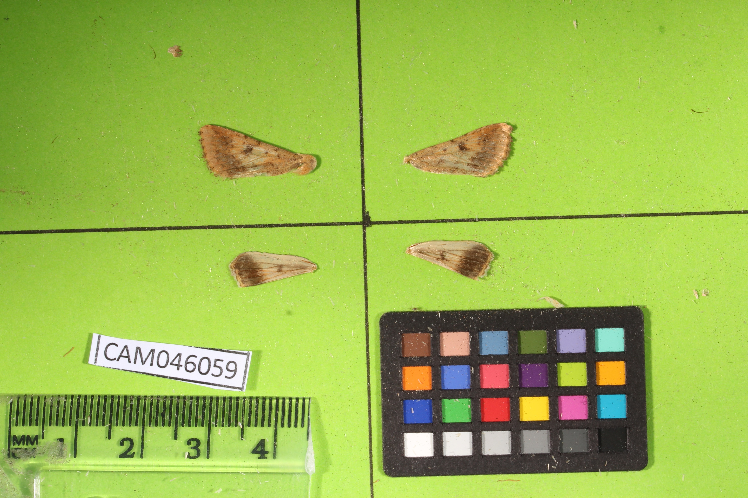
Step 1 Extracting features
Originally done using macros in ImageJ
Crop each image into 4 – one for each wing
Notes:
2 pictures for each individual – for each of ventral and dorsal sides of the wings

Slide 6
Step 1 Extracting features
Originally done using macros in ImageJ
Crop each image into 4 – one for each wing

Slide 7
Step 1 Extracting features
Originally done using macros in ImageJ
Convert RGB photo to HSB and choose Hue channel

Slide 8
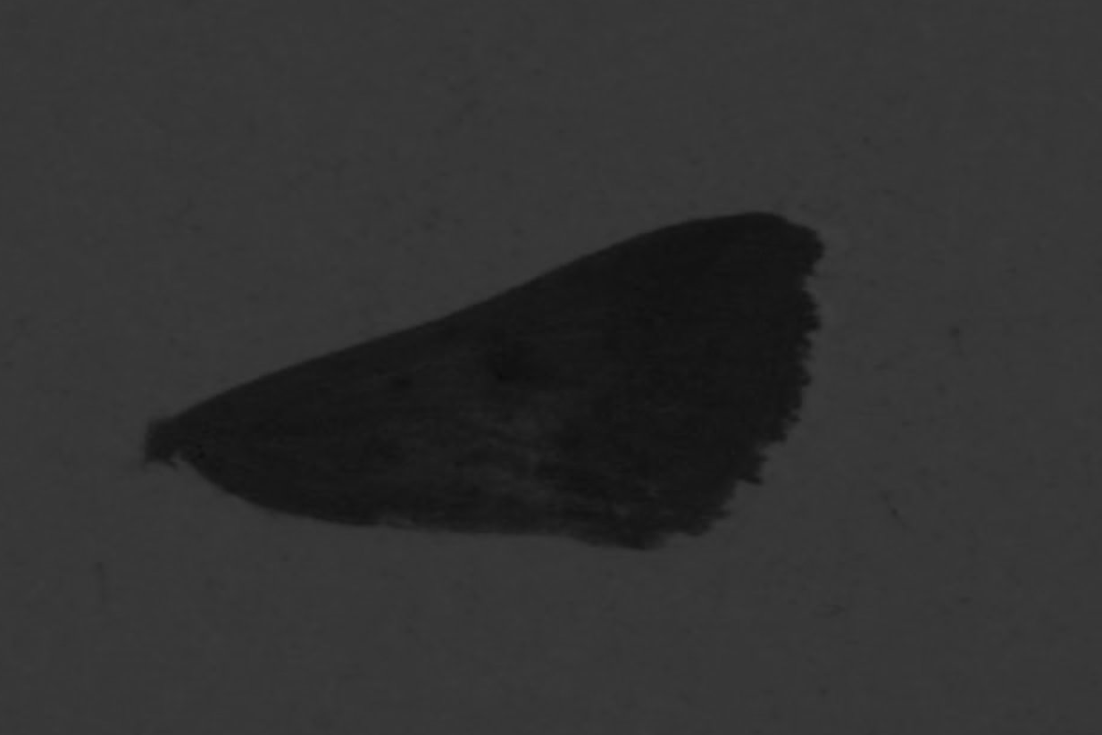
Step 1 Extracting features
Originally done using macros in ImageJ
Convert RGB photo to HSB and choose Hue channel

Slide 9
Step 1 Extracting features
Originally done using macros in ImageJ
Create a mask based on a predetermined hue threshold

Slide 10
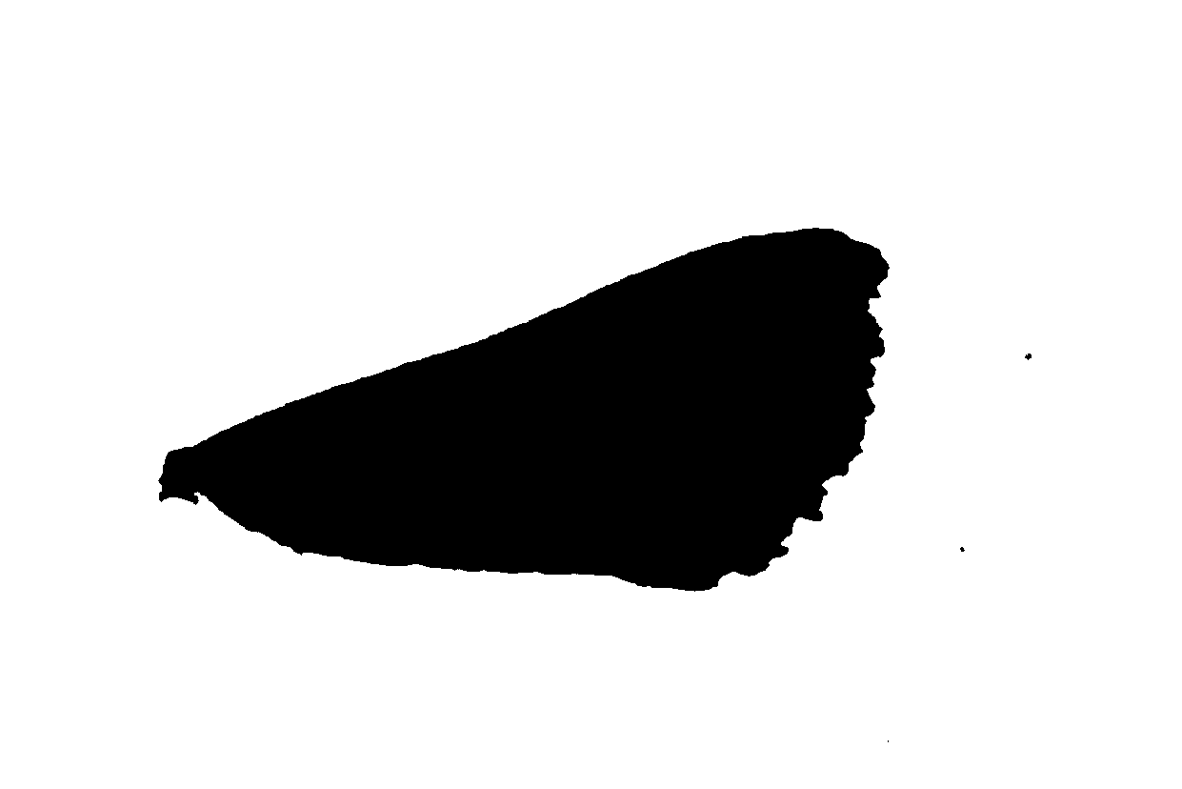
Step 1 Extracting features
Originally done using macros in ImageJ
Create a mask based on a predetermined hue threshold

Slide 11
Step 1 Extracting features
Originally done using macros in ImageJ
Measure the features of the largest shape in the image

Slide 12
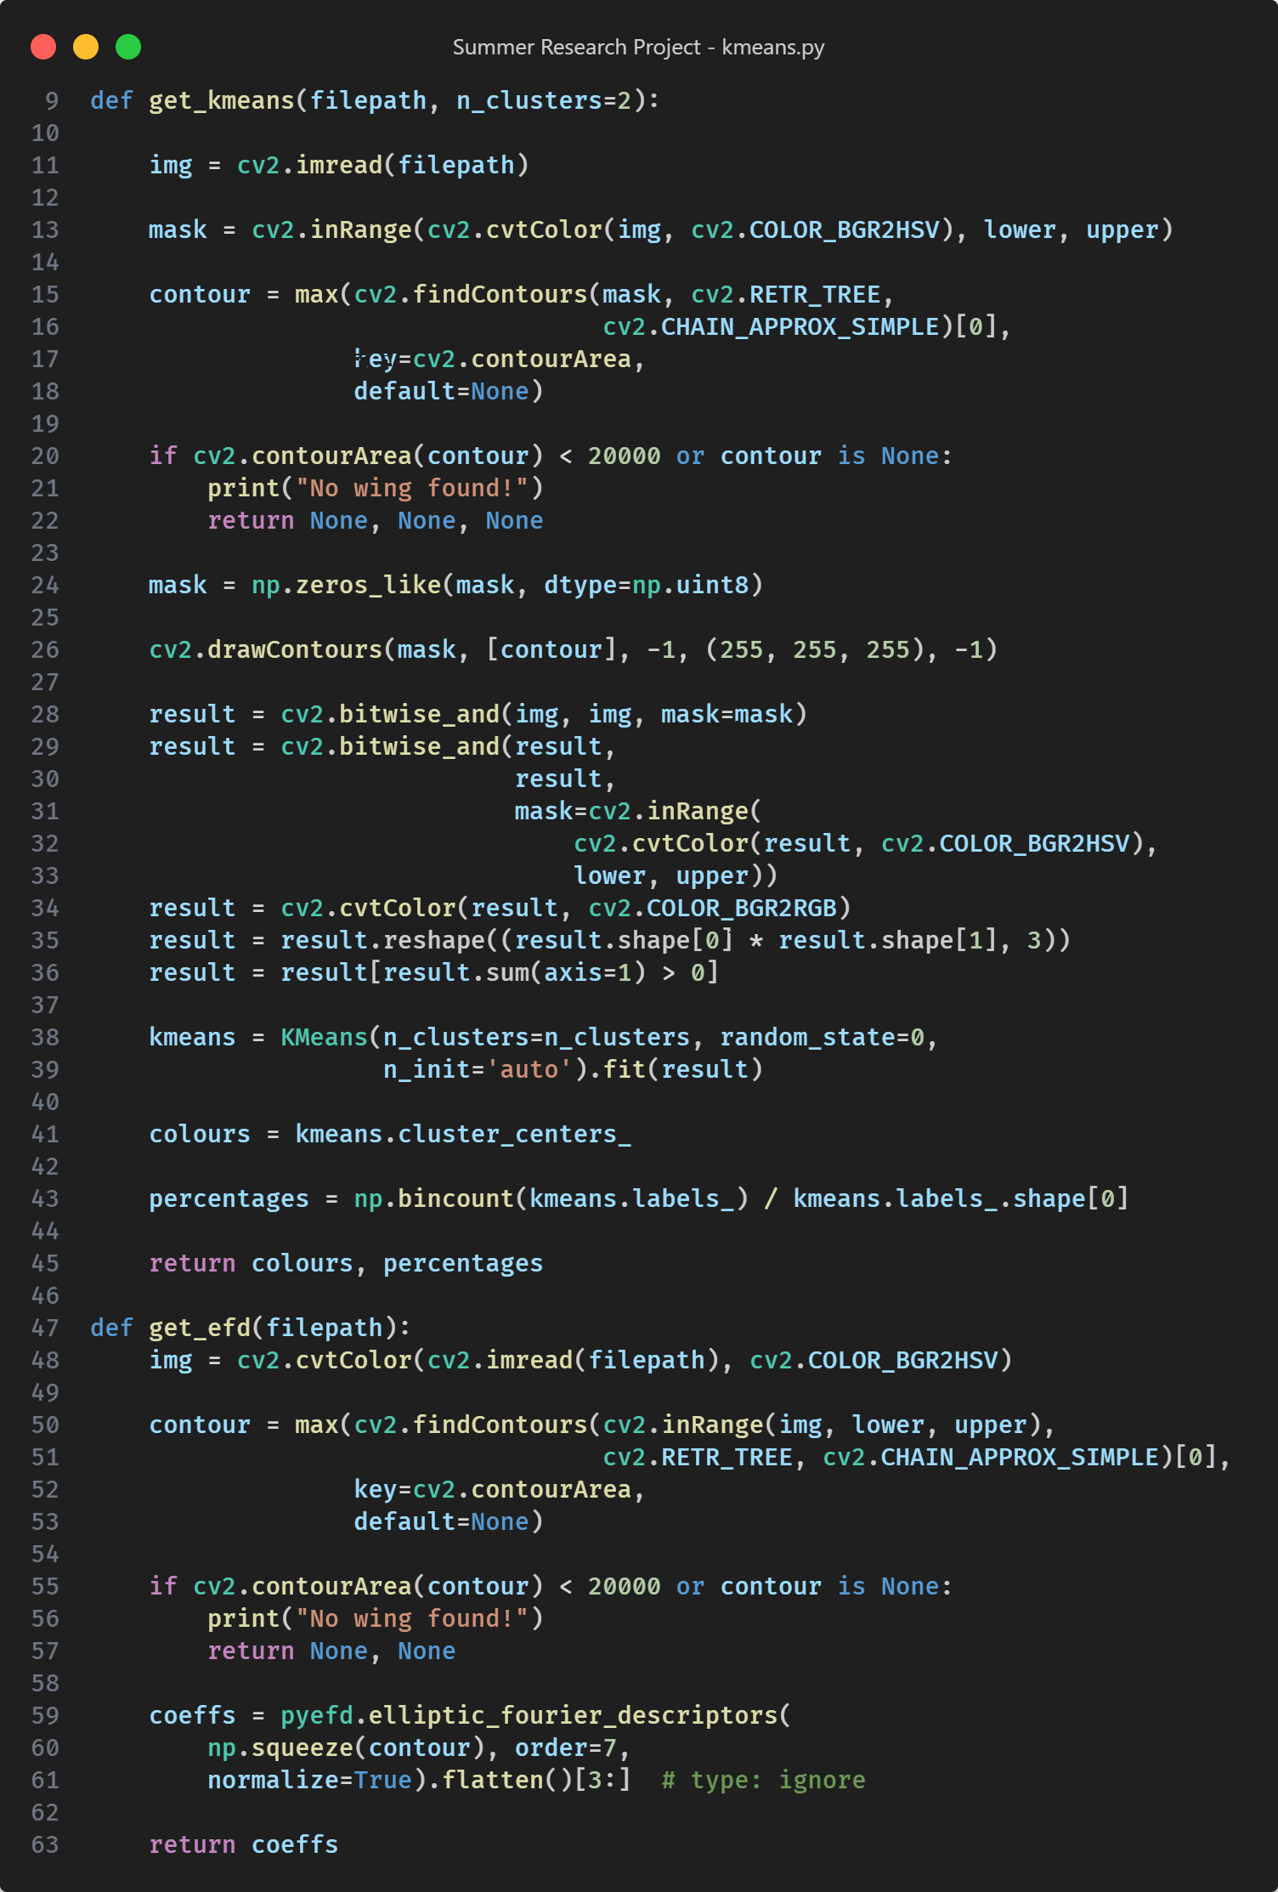
Extracting Shape and Colour
Shape – using elliptical Fourier descriptors.
Colours – using the k-means clustering algorithm.
Done in Python using the pyefd and scikit-learn packages

Slide 13
Extracted Features
Area
Major/minor axes lengths
Circularity
Feret and minimum feret
Aspect Ratio
Shape
Colours

Slide 14

Simple Algorithms
Logistic Regression
Linear Discriminant Analysis (LDA)

Slide 15

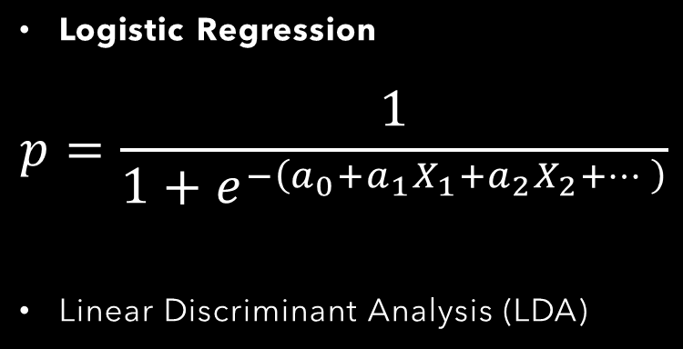
Simple Algorithms
Logistic Regression
$$p=\frac{1}{1+e^{−\left(a_{0}+a_{1}X_{1}+a_{2}X_{2}+…\right)}}$$
Linear Discriminant Analysis (LDA)

Slide 16
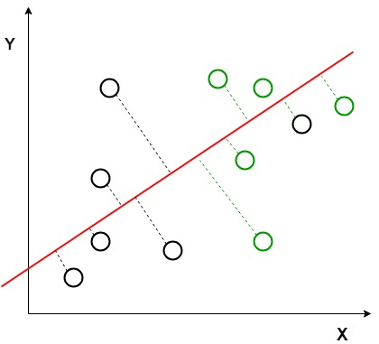
Simple Algorithms
Logistic Regression
Linear Discriminant Analysis (LDA)

Slide 17
Findings
Ignoring hybrids
Logistic Regression: 86.83% ± 1.01
LDA: 89.55% ± 1.29
Including hybrids
Logistic Regression: 76.94% ± 2.92
LDA: 77.82% ± 1.37
Hybrids – admixture between 0.05 and 0.95

Slide 18
Optimisations
Stratified splitting rather than random splitting
Cross-validation – specifically k-fold cross-validation
Less of an issue later in the process

Slide 19
Optimisations
Stratified splitting rather than random splitting
Cross-validation – specifically k-fold cross-validation
Less of an issue later in the process

Slide 20
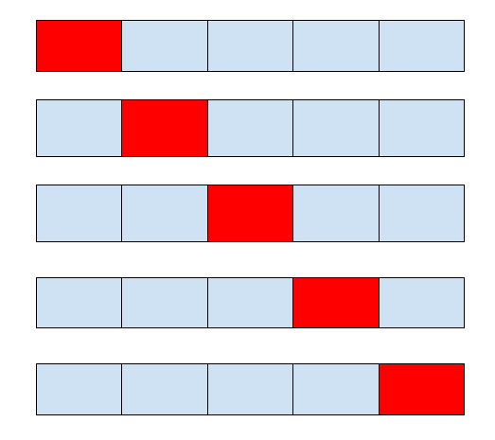
Optimisations
Stratified splitting rather than random splitting
Cross-validation – specifically k-fold cross-validation
Less of an issue later in the process

Slide 21
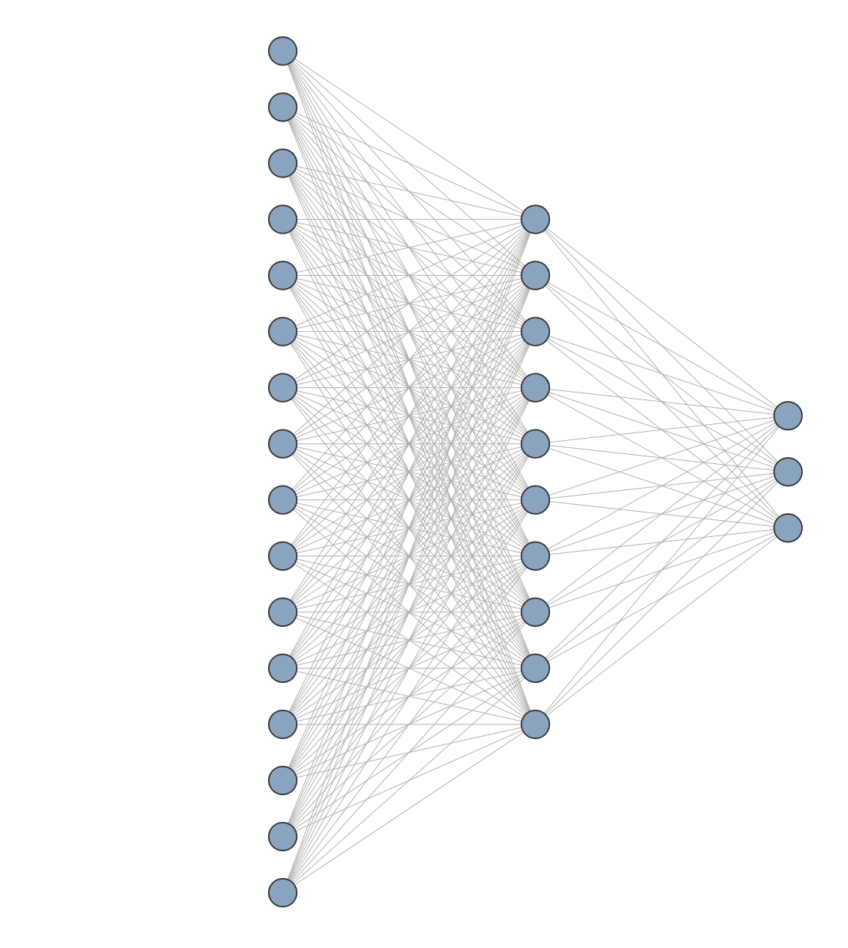
Moving onto neural networks
Using Logistic Regression and LDA as a rudimentary baseline
Initially using the same previously-determined extracted features
Best architecture seemed to be a single hidden layer with 10 nodes
Accuracy: 76.43% ± 2.31
Notes:
Looked promising, but also wished to try image-based as well

Slide 22
Image-based neural network
Using raw pixel values themselves as the input into the neural network
Average Accuracy: 71.898% ± 2.146
Using pretrained model (VGG16)
Accuracy: 72.606%
Clearly less accurate than using the extracted features

Slide 23

Refining the network
Learning rate scheduler
Early stopping
Dropout
Regularization
Batch normalisation
Different architectures
Gradient clipping

Slide 24
Refining the network
Learning rate scheduler
Early stopping
Dropout
Regularization
Batch normalisation
Different architectures
Gradient clipping
Learning rate scheduler
Early stopping
Batch normalisation
Different architectures
Early stopping
Batch normalisation
Dropout
Regularization
Different architectures
Gradient clipping
Notes:
Normalisation – training data only
Learning rate scheduler helped refinement at end

Slide 25
Refining the network
Learning rate scheduler
Early stopping
Dropout
Regularization
Batch normalisation
Different architectures
Gradient clipping
Learning rate scheduler
Early stopping
Batch normalisation
Different architectures
Accuracy: 80.50% ± 2.05
Early stopping
Batch normalisation
Dropout
Regularization
Different architectures
Gradient clipping
Notes:
Normalisation – training data only
Learning rate scheduler helped refinement at end

Slide 27
Notes:
Close LDA makes sense

Slide 28
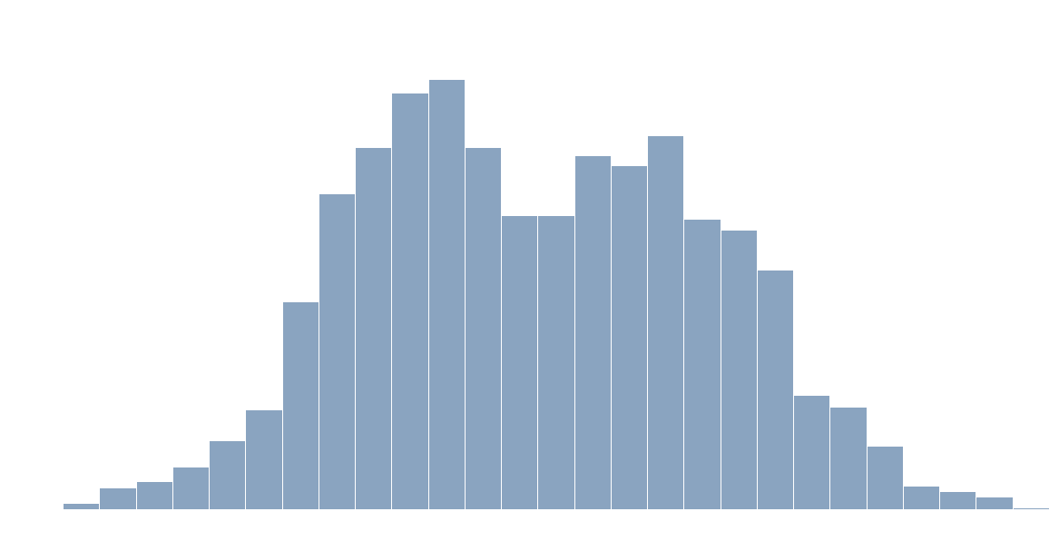

Slide 29
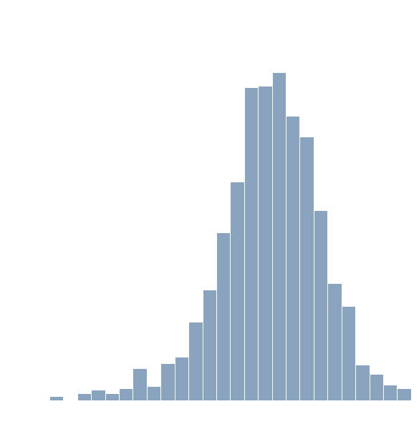
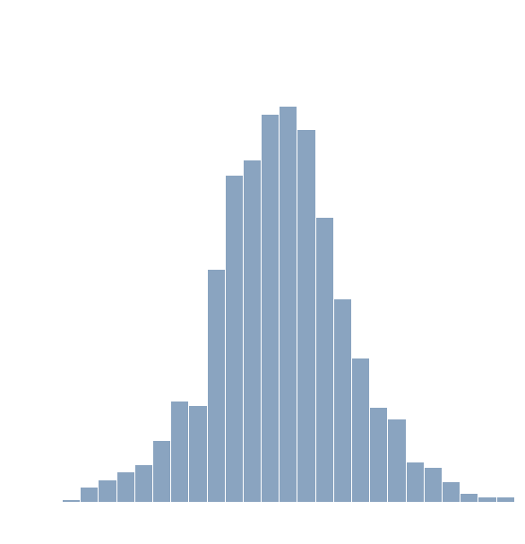

Slide 30
Pseudoreplication (aaah!)

Slide 31
Pseudoreplication
8 samples per individual – samples aren’t independent of one another
Accuracy may potentially be overstated
Best option – grouping all information for a given individual into a single sample
8x less data – performance suffers
Compromise – group samples by wings
Coupled with better splitting across training/testing sets
Replication still exists to a lesser extent, but not across training and testing sets
Notes:
Grouping level 2 technically more than 8x less data as some individuals missing all wings
Explain grouping by wing – both front and rear data for same wing grouped as single sample
All figures shown so far use grouping by wing
Training/testing also includes validation in case of neural networks

Slide 32
Class Imbalance
Notes:
72.56479% of data is arm – makes 80% accuracy less impressive

Slide 33
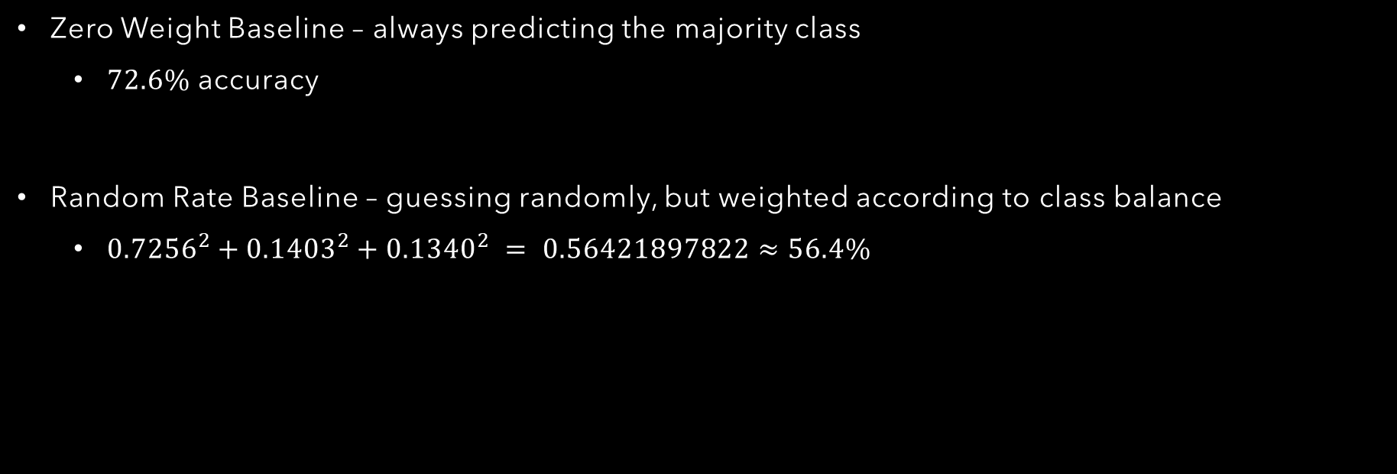
Baselines
Zero Weight Baseline – always predicting the majority class
$72.6\%$ accuracy
Random Rate Baseline – guessing randomly, but weighted according to class balance
${0.7256}^{2}+{0.1403}^{2}+{0.1340}^{2} = 0.56421897822≈56.4\%$
Notes:
In theory, NN is doing better than both baselines, so it’s definitely doing something at least, but better way to tell is to manually balance classes

Slide 34
Balancing the Classes
Over-sampling or under-sampling: both give similar results
Accuracy: 65.306% ± 6.908
Baselines in this case would be 33% (zero-weight) or 32.67% (random rate), so performance is much better.
Notes:
All this shows accuracy isn’t the best/most representative measurement

Slide 35
Performance Metrics
Accuracy isn’t the most representative measure
Confusion Matrices
Original |  | Predicted
 | Original | Armigera | Hybrid | Zea
True | Armigera | 15561 | 119 | 918
 | Hybrid | 1929 | 585 | 460
 | Zea | 1462 | 99 | 1470
Balanced |  | Predicted
 | Original | Armigera | Hybrid | Zea
True | Armigera | 9638 | 4312 | 2709
 | Hybrid | 3850 | 8925 | 3884
 | Zea | 1416 | 2556 | 12687
Notes:
Hyb mostly goes to arm
Zea 50/50 chance

Slide 36
Precision and Recall
Precision: the percentage of results which are relevant for a give
Recall: the percentage of total relevant results correctly classified.
Higher precision and recall for armigera isn’t necessary bad – it’s what we wish to detect
Original | Precision | Recall
Arm | 0.821 | 0.938
Hyb | 0.729 | 0.197
zea | 0.516 | 0.485
Balanced | Precision | Recall
Arm | 0.647 | 0.579
Hyb | 0.565 | 0.536
zea | 0.658 | 0.762
Notes:
Balance of data in training set can be manually adjusted to give desired relative precision and recall across all three categories

Slide 37
Conclusions
Machine learning works!
Changes
Notes:
Refer to original goal of detecting species using just wings

